Slide 1
Support Vector Machines

Slide 2
Objective
You will be able to
Explain the importance of Support Vector Machines both historically and today.
Nonlinear Classifiers
Applied Model complexity

Slide 3
The plan
A bit of history: Nonlinear classification
Support Vector Machines
What are they?
How do they work?
When are they useful?

Slide 4
Nonlinear Classification

Slide 5
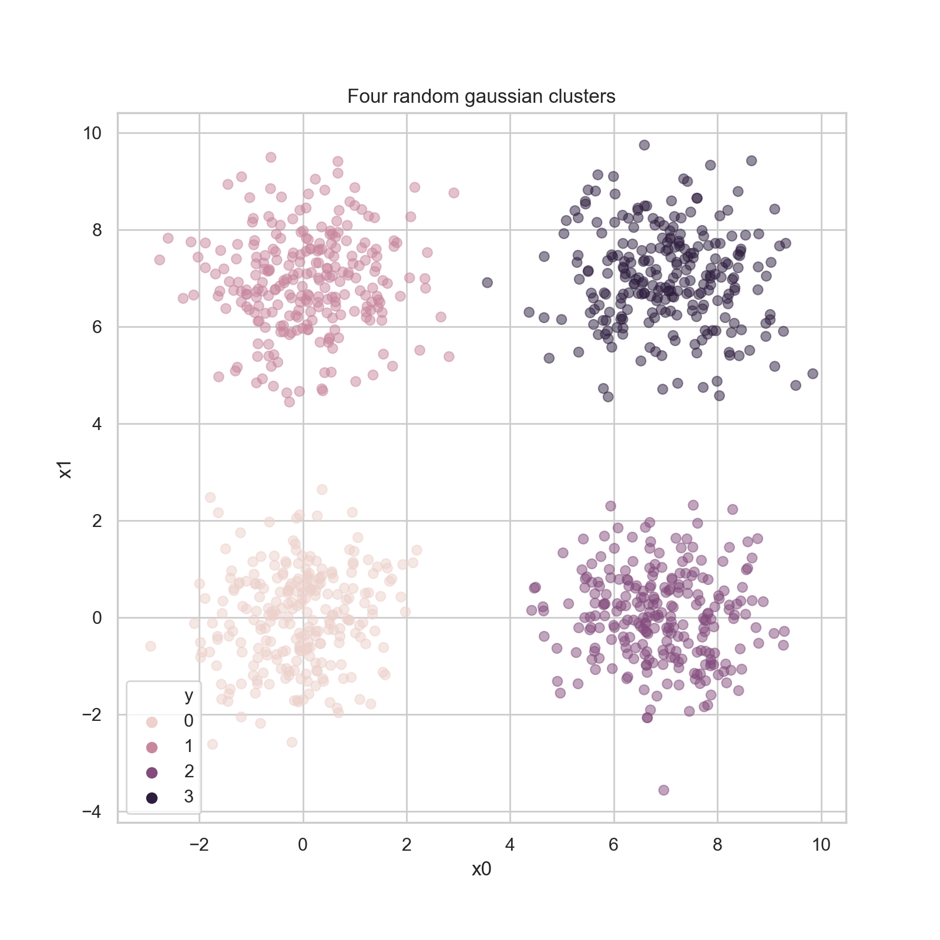
Nonlinear Classification
Example
Classification problem: four randomly generated blobs
x1, x2: Features
y: class

Slide 6
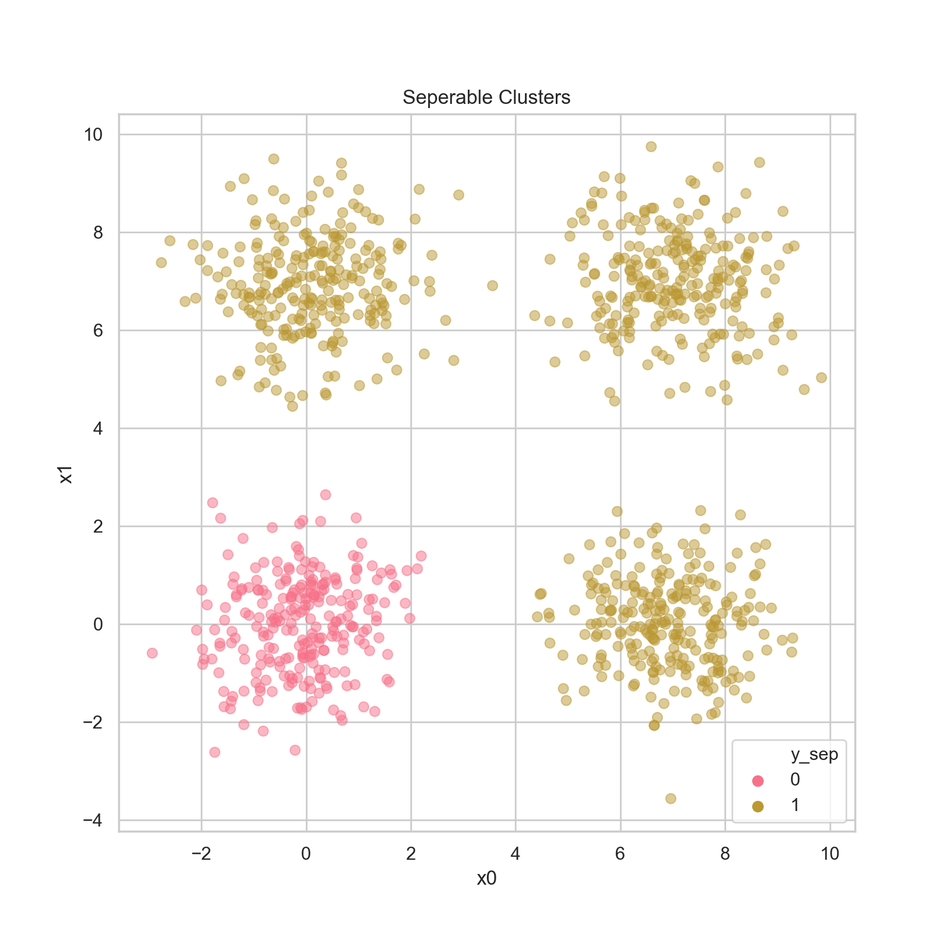
Nonlinear Classification
Easy mode: one of the clusters is in the “0” class, the rest in the “1” class.
How do you think our friend Logistic Regression will do? Guess the accuracy score you think the algorithm will get.

Slide 7
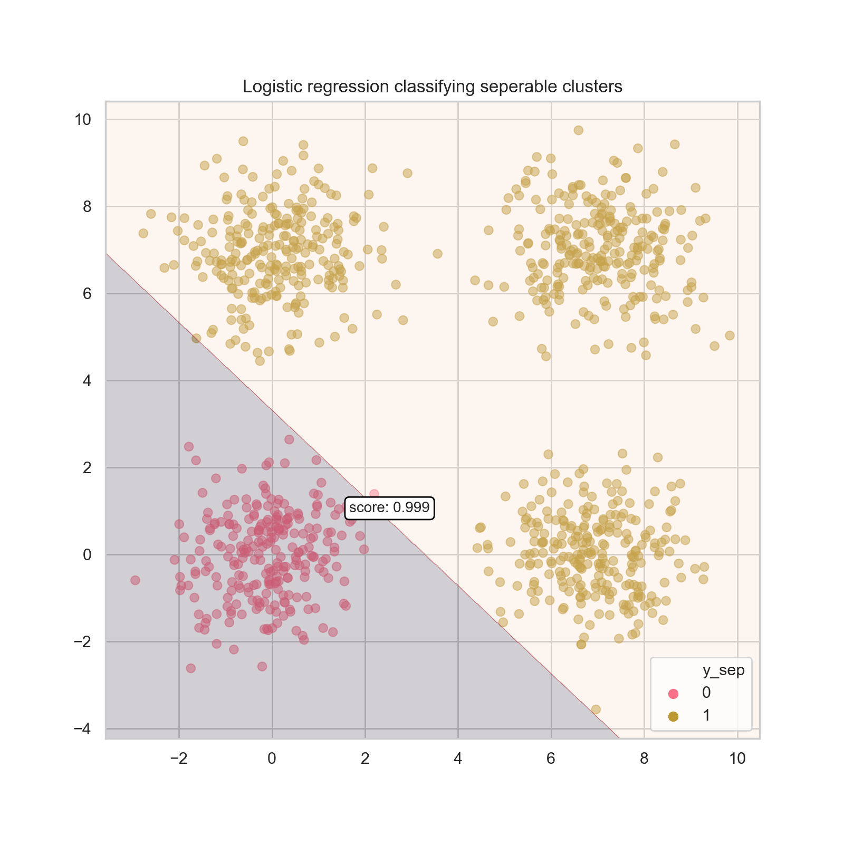
Nonlinear Classification
Easy mode: one of the clusters is in the “0” class, the rest in the “1” class.
How do you think our friend Logistic Regression will do? Guess the accuracy score you think the algorithm will get.
Essentially, perfect. Great job, LogReg <3

Slide 8
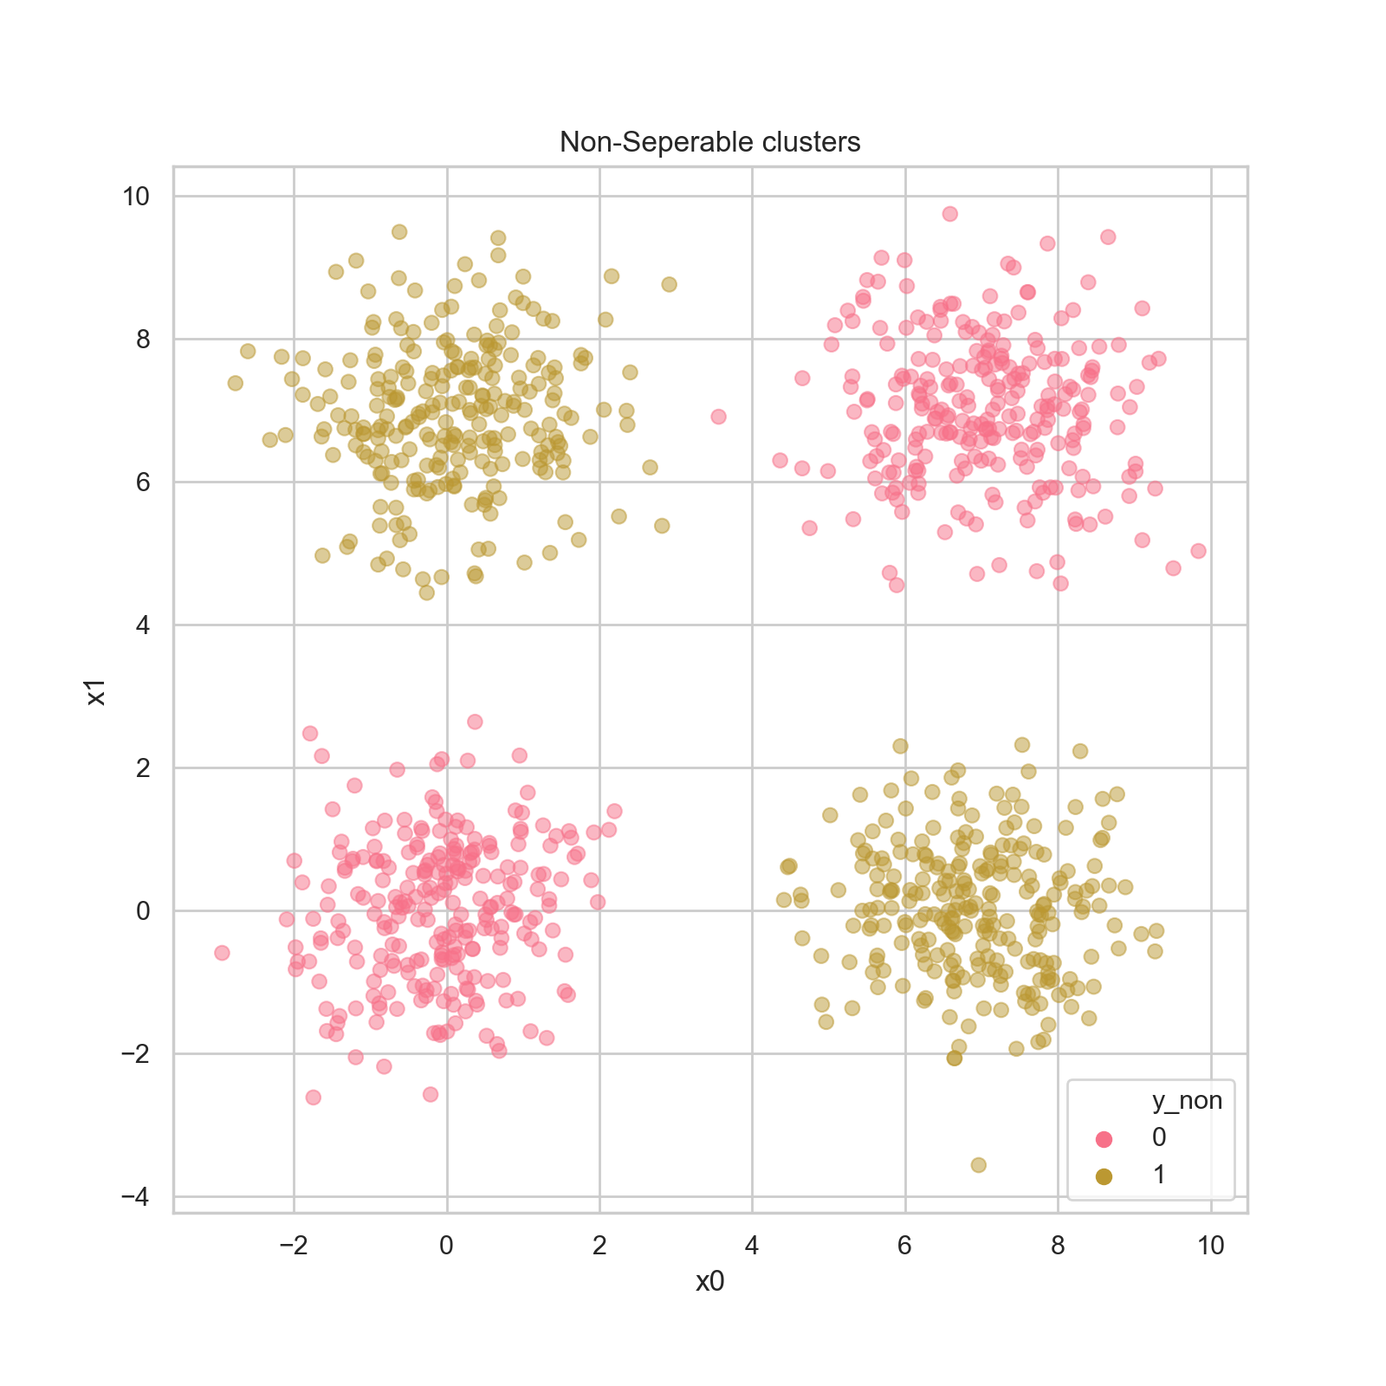
Nonlinear Classification
Easy mode: one of the clusters is in the “0” class, the rest in the “1” class.
Hard mode: two opposite clusters in each class.
How do you think Logistic Regression will do here?

Slide 9
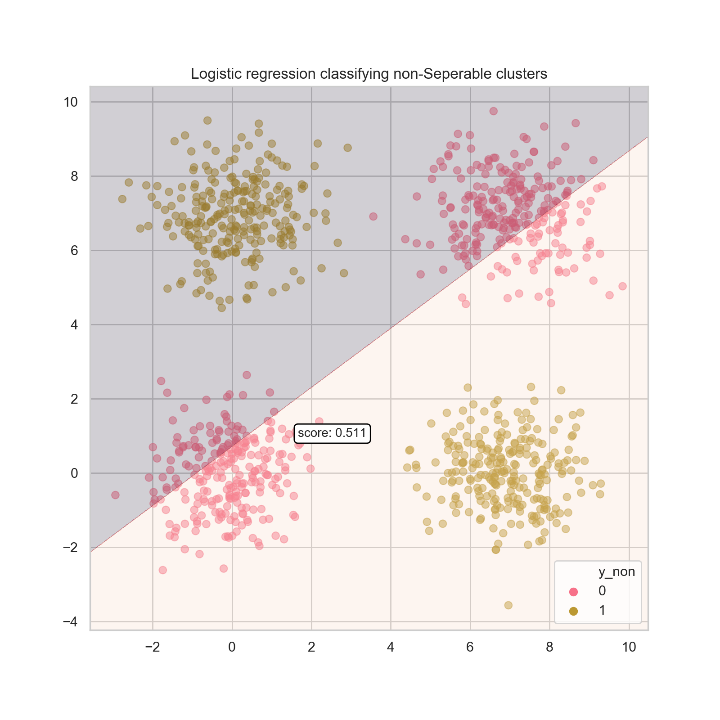
Nonlinear Classification
Easy mode: one of the clusters is in the “0” class, the rest in the “1” class.
Hard mode: two opposite clusters in each class.
How do you think Logistic Regression will do here?
Ummmm 😟
Do you know of any models that might do better?
What’s the problem?

Slide 10
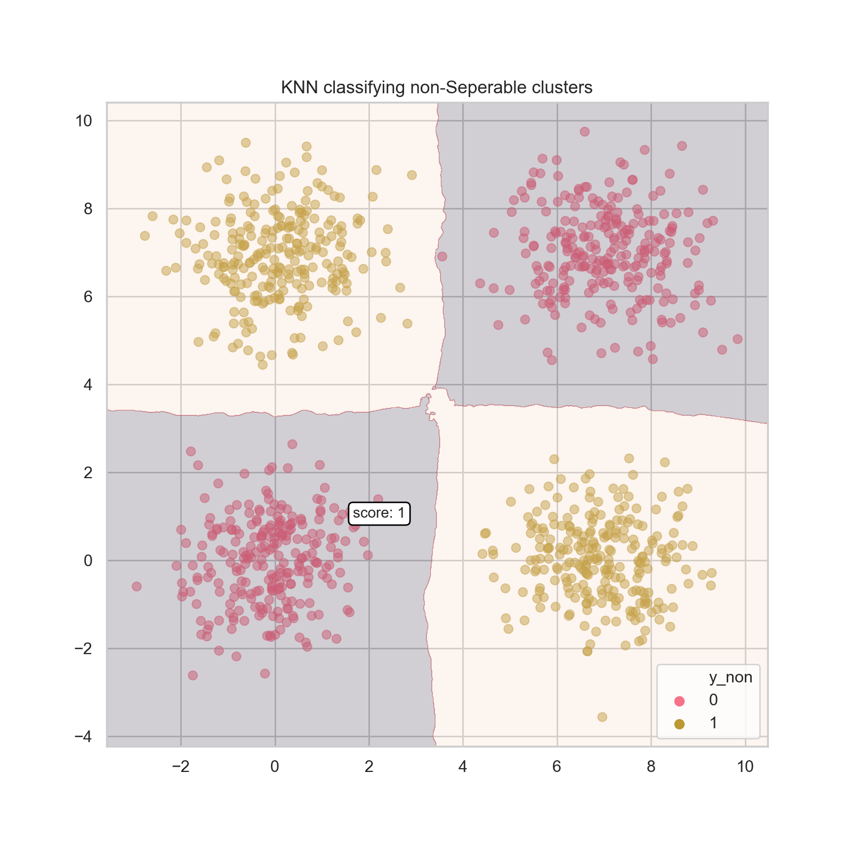
Nonlinear Classification
Easy mode: one of the clusters is in the “0” class, the rest in the “1” class.
Hard mode: two opposite clusters in each class.
How do you think Logistic Regression will do here?
Ummmm 😟
Do you know of any models that might do better?
KNN can get a perfect score 💁‍♀️
What’s the problem?

Slide 11

Nonlinear classification: what’s the problem?
Logistic Regression prediction function:
$y_{p}=σ(x^{T}w+b)$

Slide 12
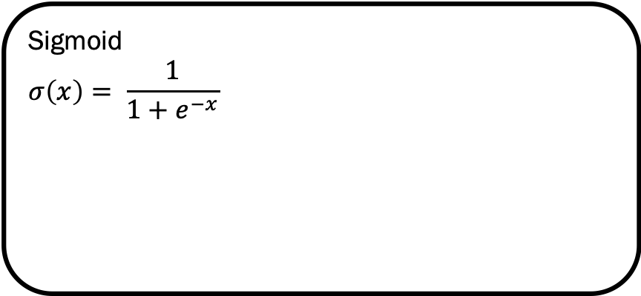

Nonlinear classification: what’s the problem?
Sigmoid
$$σ\left(x\right)= \frac{1}{1+e^{−x}}$$
Logistic Regression prediction function:
$y_{p}=σ(x^{T}w+b)$

Slide 13
Nonlinear classification: what’s the problem?
Logistic Regression prediction function:
$y_{p}=σ(x^{T}w+b)$
Linear operation

Slide 14

Nonlinear classification: what’s the problem?
Logistic Regression prediction function:
$y_{p}=σ(x^{T}w+b)$
Linear classifiers (like Logistic Regression) may only segment a space by using a hyperplane.
In 2-dimensions, a hyperplane is just a line.

Slide 15
Nonlinear classification: what’s the problem?
Logistic Regression prediction function:
$y_{p}=σ(x^{T}w+b)$
Linear classifiers (like Logistic Regression) may only segment a space by using a hyperplane.
In 2-dimensions, a hyperplane is just a line.

